Slide 1
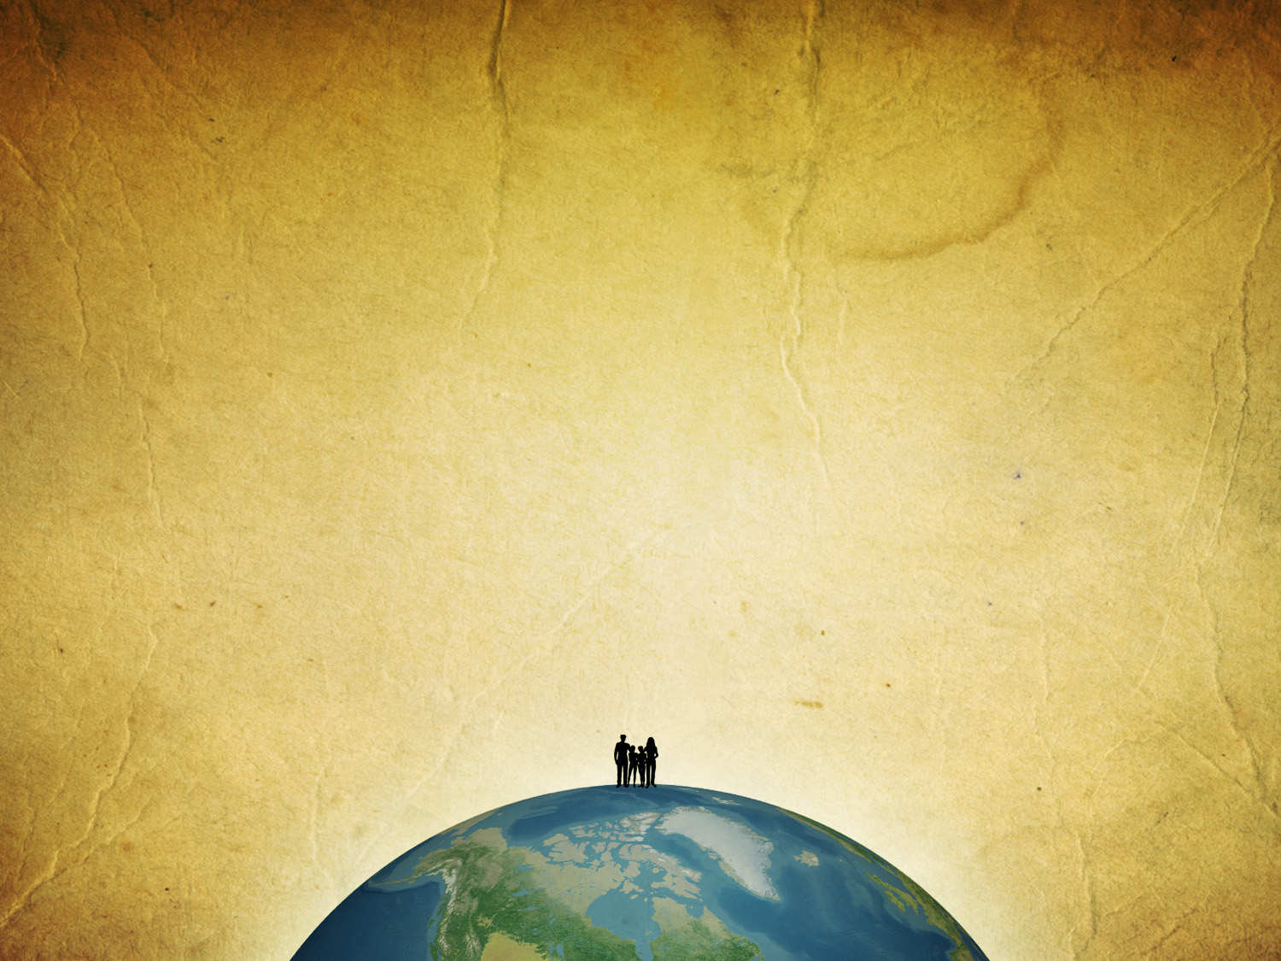
How does God work in your life?

Slide 2
Does your prayer life sometimes frustrate you?

Slide 3
Will He really
find faith
on the earth?

Slide 4
Psalm 104:10-24
10 He sends the springs into the valleys, they flow among the hills. 11 They give drink to every beast of the field; the wild donkeys quench their thirst. 12 By them the birds of the heavens have their home; they sing among the branches. 13 He waters the hills from His upper chambers; the earth is satisfied with the fruit of Your works. 14 He causes the grass to grow for the cattle, and vegetation for the service of man, that He may bring forth food from the earth,

Slide 5
15 And wine that makes glad the heart of man, oil to make his face shine, And bread which strengthens man's heart. 16 The trees of the LORD are full of sap, the cedars of Lebanon which He planted, 17 Where the birds make their nests; the stork has her home in the fir trees. 18 The high hills are for the wild goats; the cliffs are a refuge for the rock badgers. 19 He appointed the moon for seasons; the sun knows its going down. 20 You make darkness, and it is night, in which all the beasts of the forest creep about.

Slide 6
21 The young lions roar after their prey, and seek their food from God. 22 When the sun rises, they gather together and lie down in their dens. 23 Man goes out to his work and to his labor until the evening. 24 O LORD, how manifold are Your works! In wisdom You have made them all.

Slide 7
General Providence
Special Providence

Slide 8
General Providence
those things set in motion by the
laws of nature which God superintends

Slide 9
I returned and saw under the sun that—The race is not to the swift, nor the battle to the strong, nor bread to the wise, nor riches to men of understanding, nor favor to men of skill; but time and chance happen to them all.
Ecclesiastes 9:11

Slide 10
Special Providence
those things that God does
in the world for a specific purpose

Slide 11
‘This decision is by the decree of the watchers, and the sentence by the word of the holy ones, in order that the living may know that the Most High rules in the kingdom of men; He gives it to whomever He will, and sets over it the lowest of men.’
Daniel 4:17

Slide 12
22 “Men of Israel, hear these words: Jesus of Nazareth, a Man attested by God to you by miracles, wonders, and signs which God did through Him in your midst, as you yourselves also know— 23 Him, being delivered by the determined purpose and foreknowledge of God, you have taken by lawless hands, have crucified, and put to death; 24 whom God raised up, having loosed the pains of death, because it was not possible that He should be held by it.
Acts 2:22-24

Slide 13
General and
Special providence
look the same

Slide 14
So…
what is my answer
to providence?

Slide 15
16 When I applied my heart to know wisdom and to see the business that is done on earth, even though one sees no sleep day or night, then I saw all the work of God, that a man cannot find out the work that is done under the sun. 17 For though a man labors to discover it, yet he will not find it; moreover, though a wise man attempts to know it, he will not be able to find it.
Ecclesiastes 8:16-17

Slide 16
For if you remain completely silent at this time, relief and deliverance will arise for the Jews from another place, but you and your father's house will perish. Yet who knows whether you have come to the kingdom for such a time as this?”
Esther 4:14

Slide 17
15 For perhaps he departed for a while for this purpose, that you might receive him forever, 16 no longer as a slave but more than a slave—a beloved brother, especially to me but how much more to you, both in the flesh and in the Lord.
Philemon 15-16

Slide 18
Prayer
My words to God, in part,
to ask Him to act on my behalf

Slide 19
“pray without ceasing”
1 Thessalonians 5:17

Slide 20
1 In those days Hezekiah was sick and near death. And Isaiah the prophet, the son of Amoz, went to him and said to him, “Thus says the Lord: ‘Set your house in order, for you shall die, and not live.’ ” 2 Then he turned his face toward the wall, and prayed to the Lord, saying, 3 “Remember now, O Lord, I pray, how I have walked before You in truth and with a loyal heart, and have done what was good in Your sight.” And Hezekiah wept bitterly. 4 And it happened, before Isaiah had gone out into the middle court, that the word of the Lord came to him, saying, 5 “Return and tell Hezekiah the leader of My people, ‘Thus says the Lord, the God of David your father: “I have heard your prayer, I have seen your tears; surely I will heal you. On the third day you shall go up to the house of the Lord. 6 And I will add to your days fifteen years.
2 Kings 20:1-6

Slide 21
1 Then He spoke a parable to them, that men always ought to pray and not lose heart, 2 saying: “There was in a certain city a judge who did not fear God nor regard man. 3 Now there was a widow in that city; and she came to him, saying, ‘Get justice for me from my adversary.’ 4 And he would not for a while; but afterward he said within himself, ‘Though I do not fear God nor regard man, 5 yet because this widow troubles me I will avenge her, lest by her continual coming she weary me.’ ” 6 Then the Lord said, “Hear what the unjust judge said. 7 And shall God not avenge His own elect who cry out day and night to Him, though He bears long with them? I tell you that He will avenge them speedily.
Luke 18:1-7

Slide 22
Faith
“Nevertheless, when the
Son of Man comes, will He
really find faith on the earth?”
Luke 18:8

